Slide 1
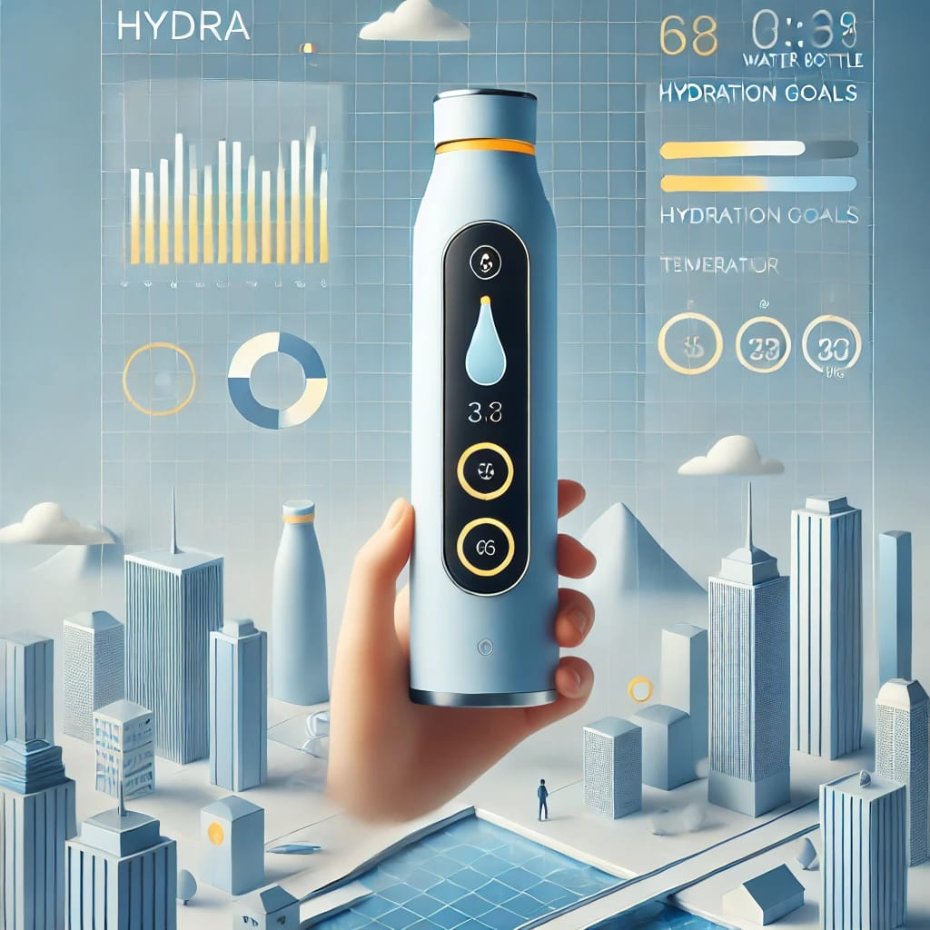
1. Product and Ambiguous Problem
Product: Smart Water Bottle Hyder
Ambiguous Problem: Users forget to hydrate regularly or don’t track their water intake effectively, leading to dehydration or health issues.
2. Design Thinking Process
You can structure the Design Thinking board using the following steps:
Empathize
User Research: Conduct surveys and interviews with potential users about their hydration habits and challenges.
User Personas: Create profiles for different types of users (e.g., athletes, office workers, busy parents).
Define
Problem Statement: "Busy individuals often forget to drink enough water throughout the day due to their hectic schedules."
Ideate
Brainstorm Solutions:
Reminder notifications on the water bottle or connected app.
Visual cues (e.g., color change) to indicate hydration levels.

Slide 2
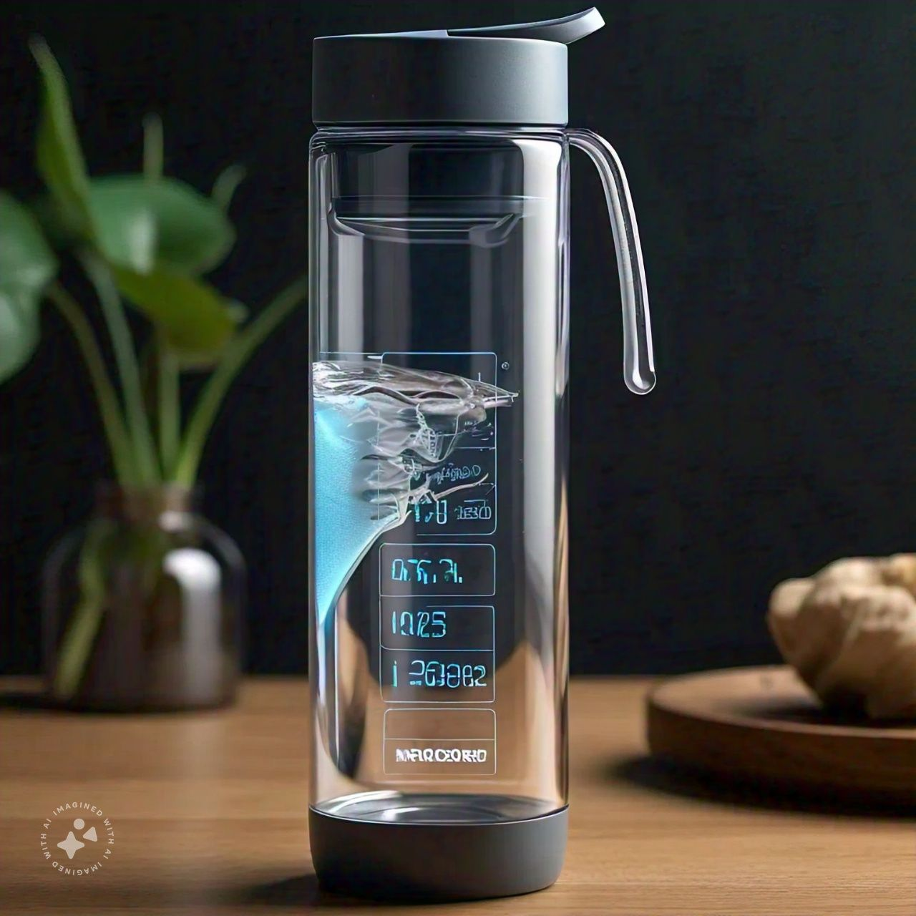
Ideate
Brainstorm Solutions:
Reminder notifications on the water bottle or connected app.
Visual cues (e.g., color change) to indicate hydration levels.
Integration with fitness apps for personalized hydration goals.
Prototype
Low-Fidelity Prototypes:
Sketches of the water bottle with reminder features.
Mockup of the app interface showing daily water intake tracking.
Test
User Testing: Gather feedback on the prototypes through focus groups and adjust based on user input.
Iterate: Refine features based on testing results and further user engagement

